Slide 1
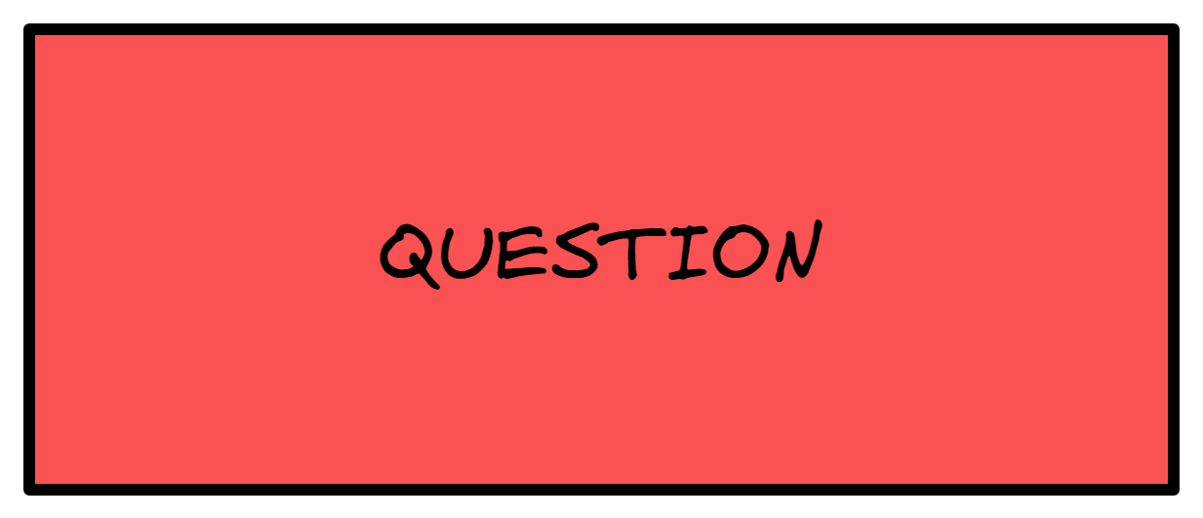

Slide 2
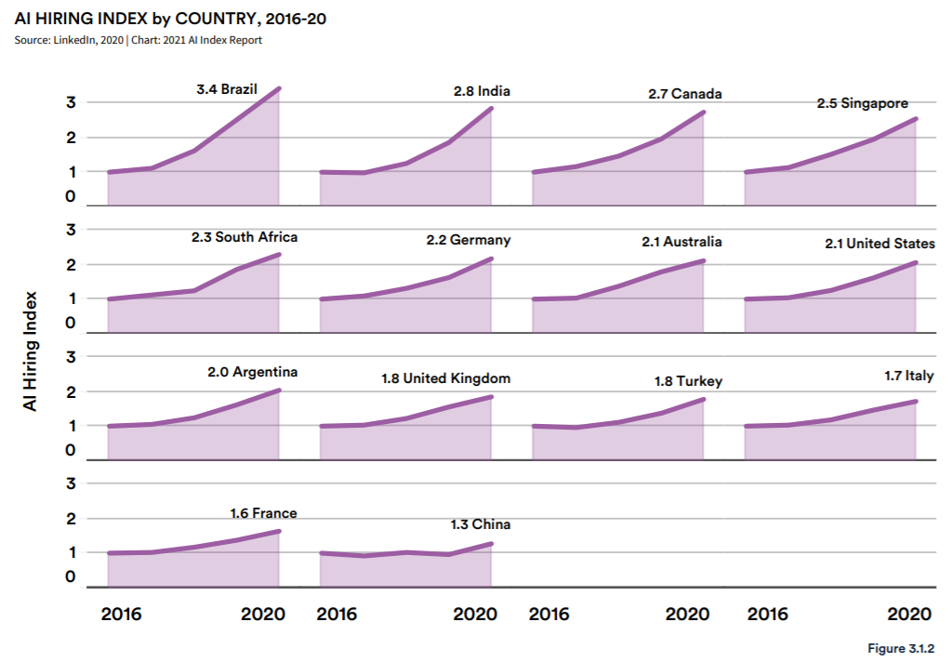
Data Science – Future Peek
"How rapidly is the growth of AI jobs in different countries?"
This data suggests that the hiring rate has been increasing across all sample countries in 2020.
Notes:
Brazil, India, Canada, Singapore, and South Africa are the countries with the highest growth in AI hiring from 2016 to 2020 (Figure 3.1.1). Across the 14 countries analyzed, the AI hiring rate in 2020 was 2.2 times higher, on average, than that in 2016. For the top country, Brazil, the hiring index grew by more than 3.5 times. Moreover, despite the COVID-19 pandemic, AI hiring continued its growth across the 14 sampled countries in 202

Slide 3
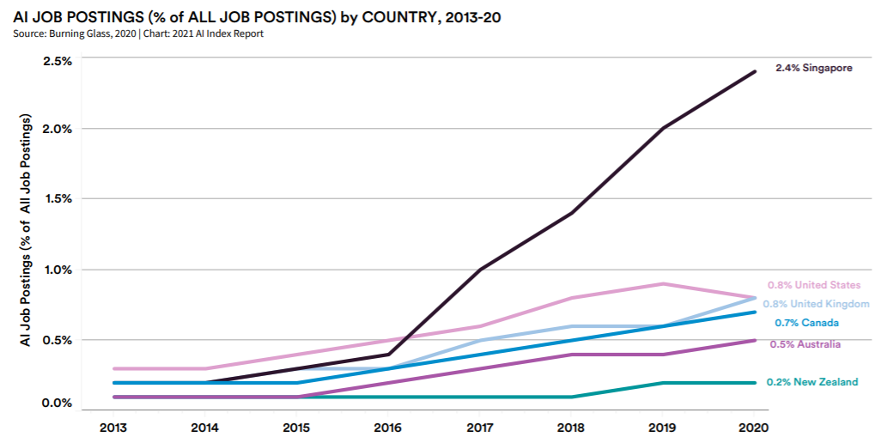
Data Science – Future Peek
"How strong is the demand for labor?"
Demand for AI labor, in 6 countries covered by data, has grown significantly in the last 7 years.
Notes:
To develop a comprehensive, real-time portrait of labor market demand, Burning Glass aggregated job postings, removed duplicates, and extracted data from job posting text.
On average, the share of AI job postings among all job postings in 2020 is more than five times larger than in 2013. Of the six countries, Singapore exhibits the largest growth, as its percentage of AI job postings across all job roles in 2020 is 13.5 times larger than in 2013. The United States is the only country among the six that recorded a decrease in its share of AI job postings from 2019 to 2020—the first drop in six years. This may be due to the coronavirus pandemic or the country’s relatively more mature AI labor market.

Slide 4
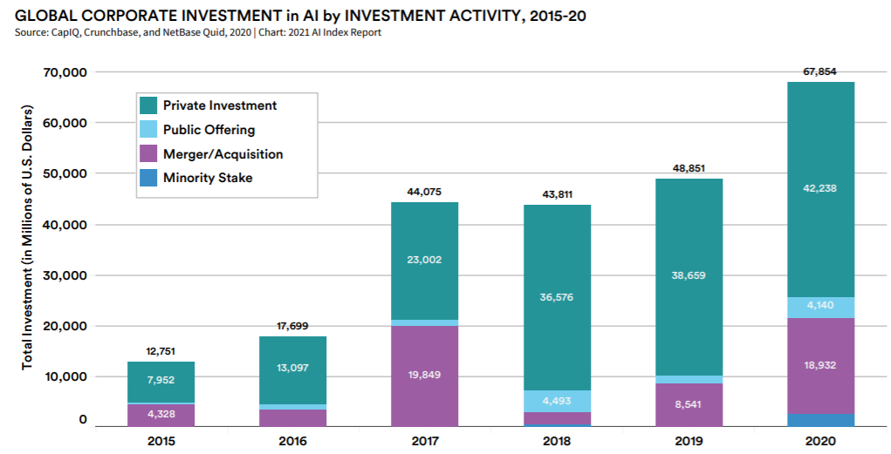
Data Science – Future Peek
"How strong is the market support (i.e. investment)?"
The total global investment in AI increased by 40% in 2020 relative to 2019 ( $67.9 billion).
Notes:
The total global investment in AI, including private investment, public offerings, M&A, and minority stakes, increased by 40% in 2020 relative to 2019 for a total of USD 67.9 billion.
Given the pandemic, many small businesses have suffered disproportionately. As a result, industry consolidation and increased M&A activity in 2020 are driving up the total corporate investment in AI. M&A made up the majority of the total investment amount in 2020, increasing by 121.7% relative to 2019

Slide 5
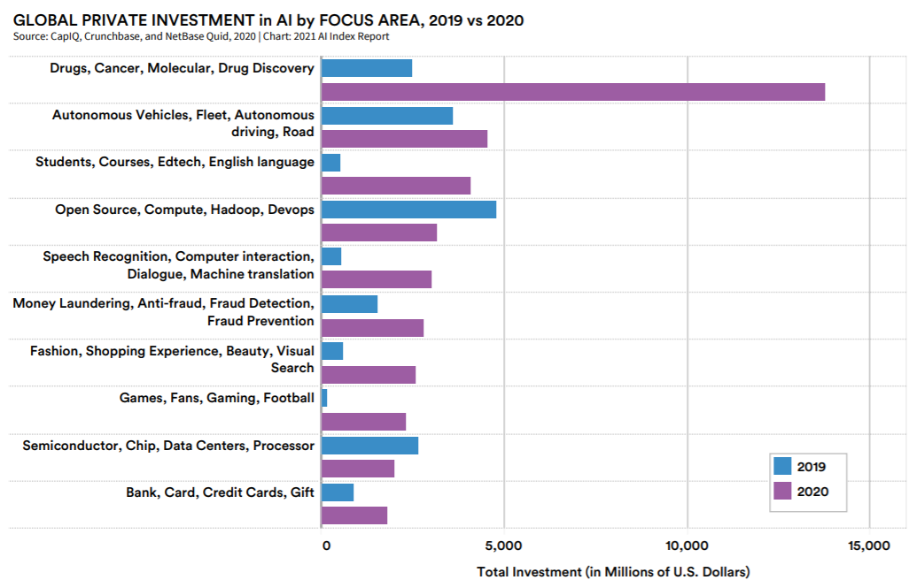
Data Science – Future Peek
"What are the strong areas of focus by investments?"
The “Drugs, Cancer, Molecular, Drug Discovery” area tops the list of AI investment—4.5 times higher than 2019 (COVID-19).
Notes:
The ranking of the top 10 focus areas that receive the greatest amount of private investment in 2020 as well as their respective investment amount in 2019.
The “Drugs, Cancer, Molecular, Drug Discovery” area tops the list, with more than USD 13.8 billion in private AI investment—4.5 times higher than 2019— followed by “Autonomous Vehicles, Fleet, Autonomous Driving, Road” (USD 4.5 billion), and “Students, Courses, Edtech, English Language” (USD 4.1 billion). In addition to Drugs, Cancer, Molecular, Drug Discovery,” both “Games, Fans, Gaming, Football” and “Students, Courses, Edtech, English Language” saw a significant increase in the amount of private AI investment from 2019 to 2020.

Slide 6
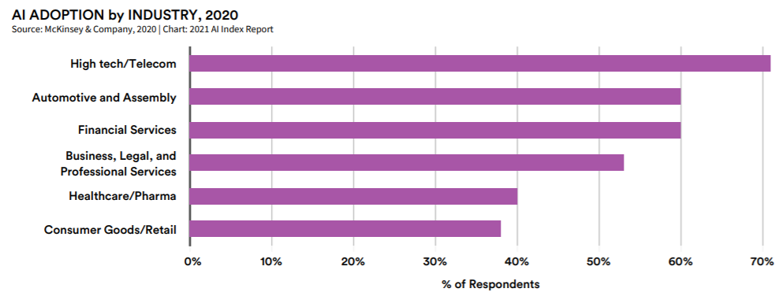
Data Science – Future Peek
"What are the strongest industries that use AI?"
High tech and telecom were most likely to report AI adoption in 2020 followed in second place by both financial services and automotive and assembly.

Slide 7

Data Science – Future Peek
"The future of AI is trending up. Hence, AI is for here to stay."
Despite the COVID-19 pandemic, the AI hiring rate has been increasing across all sample countries in 2020.
On average, the share of AI job postings among all job postings in 2020 is more than five times larger than in 2013.
Global investments in AI have increased by 40% (from $48B to $68B).
“Drugs, Cancer, Molecular, Drug Discovery” received the greatest amount of private AI investment.
Adaption remains constant (or trends up) despite COVID-19 pandemic signifying the importance and future of AI in today's society.

Slide 8

"I suppose it is tempting, if the only tool you have is a hammer, to treat everything as if it were a nail."
Abraham Maslow

Slide 9
Data Science – Problem Type
What kind of problems can we solve with data science?
Data science application offers solutions to all kinds of domains, like banking (fraud detection), e-commerce (recommendation system), and medical applications (tumor detection). Although, each use case is different, most problems fall under a few distinct set of categories.
Category | Examples | Input | Output
Predicting an output based on an input | Classification (Categorical output) | Weight & Height | Cat, Dog
 | Regression (Numerical output) | Parent 1 Height, Parent 2 Height | 5', 5'5", 6'
Learning relationships and structures from input (no input exists) | Clustering | Tumor Scans | N/A
 | Neural Networks | Live Traffic Updates | N/A
Notes:
Types of ml learning
https://www.practicalai.io/categorizing-machine-learning-problems/
https://www.youtube.com/watch?v=63AP5a_4_sA

Slide 10
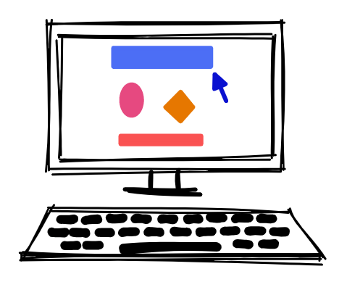
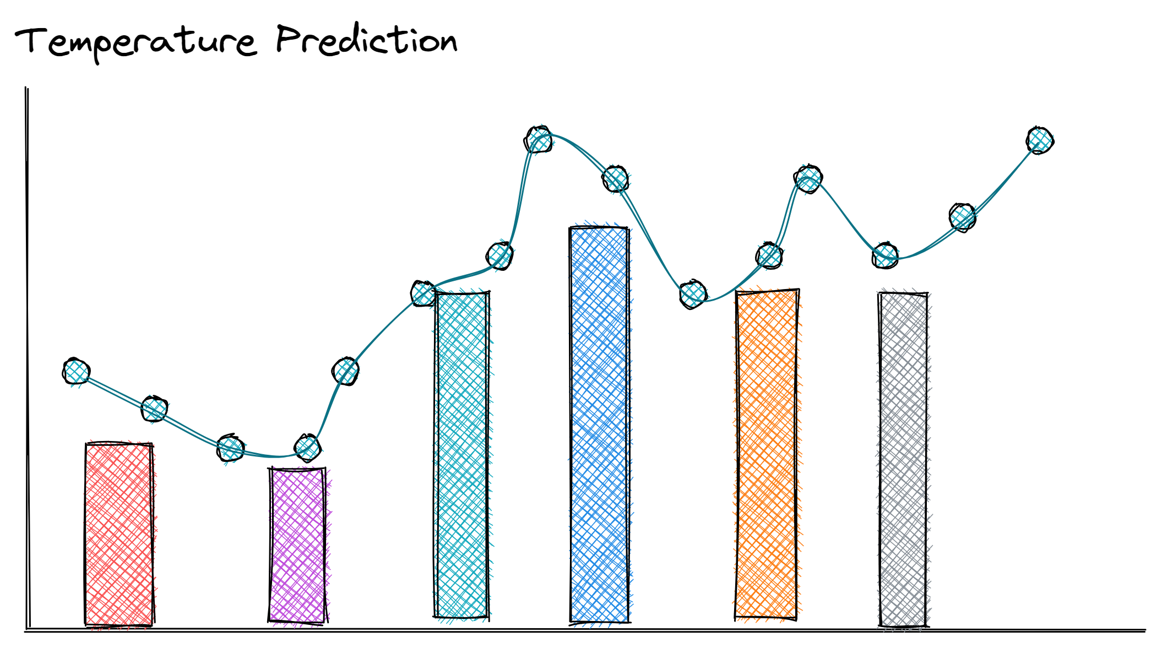

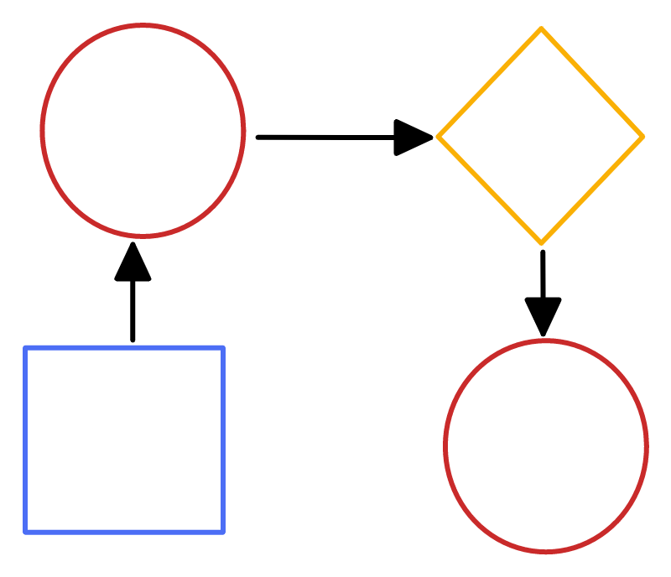
Data Science – Problem Type
What kind of problems can we solve with data science?
ML excels at prediction problems (assuming the data is of high quality and in abundance), and is not as suited for inference- explaining the reasons behind the state of things.
Good application
Predicting the likelihood that a certain type of user will click on a certain kind of ad or future temperature predictions.
Bad application
Understanding context (e.g. sarcasm), or being able to explicitly demonstrate the reasoning behind decisions.
Notes:
Good & Bad ML application
https://hbr.org/2016/11/how-to-tell-if-machine-learning-can-solve-your-business-problem

Slide 11
Data Science – Inference vs Prediction
"ML is better at making decisions than giving you insights. If you have a bunch of data and want to find out "interesting" things about it, statistical approaches make more sense."-Google
Inference, to learn about the underlying relationships within the data and reach general claims.
Prediction, the ability to predict a future outcome/observation based on a particular model.
Decision, the ability to turn knowledge into wisdom (i.e. apply what is predicted effectively).
INFERENCE
Hypothesis Testing
Confidence Interval
ANOVA
Regression /Chi Square
PREDICTION | DECISION
What video the learner wants to watch next. | Show those videos in the recommendation bar.
Probability someone will click on a search result. | If P(click) > 0.12, prefetch the web page.
Traditional
Novel
"Aim to make decisions, not just predictions."
Notes:
Inference vs Prediction ; Understand (inference) vs Predict
https://www.datasciencecentral.com/inference-vs-prediction-in-one-picture/
https://www.coursera.org/lecture/statistical-genomics/inference-vs-prediction-8-52-PkWHh
https://askanydifference.com/difference-between-inference-and-prediction/

Slide 12
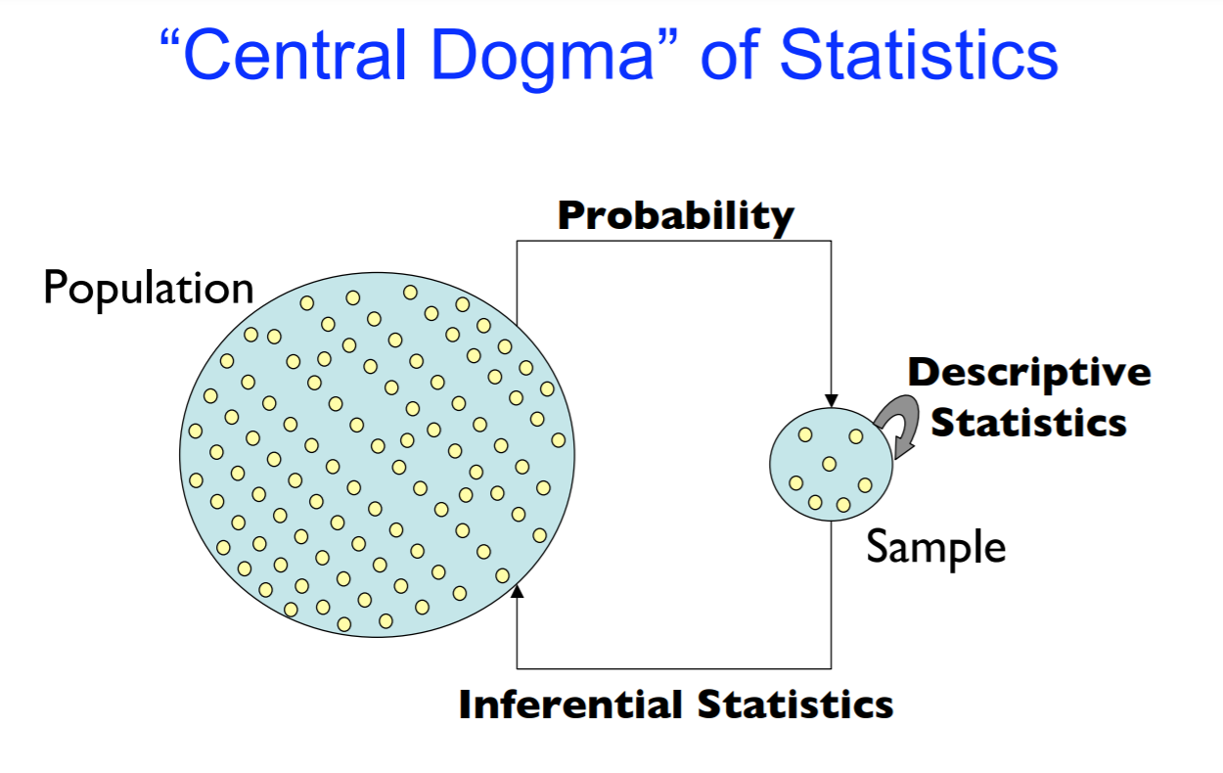
Data Science – Inference vs Prediction
By Joshua Akey

Slide 13
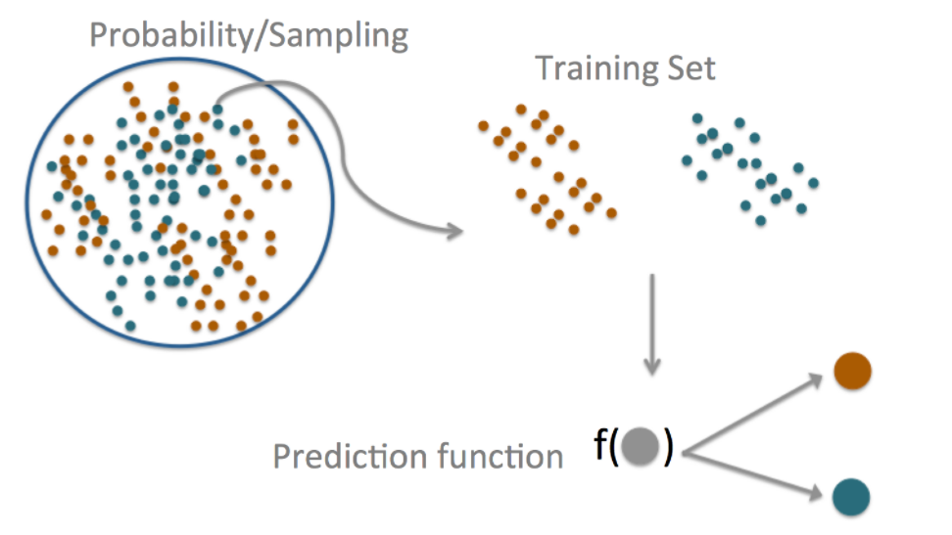
Data Science – Inference vs Prediction
"Central Dogma of Prediction"
By Jeff Leek

Slide 14
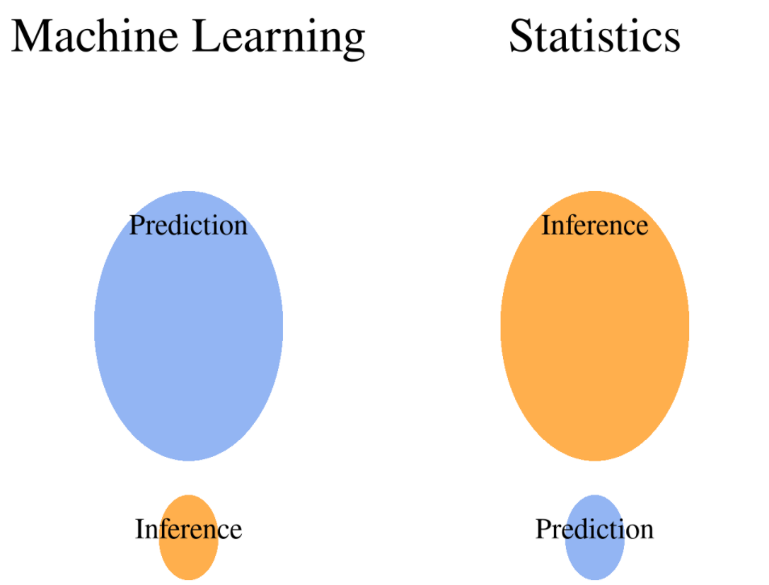
Data Science – Inference vs Prediction
By Matthias Döring

Slide 15

Data Science – Inference vs Prediction
For example, in a real estate setting, one may seek to relate values of homes to inputs such as crime rate, zoning, distance from a river, air quality, schools, income level of community, size of houses, and so forth.
Inference problem
Interested in how the individual input variables affect the prices—that is, how much extra will a house be worth if it has a view of the river?
Prediction problem
Interested in predicting the value of a home given its characteristics: is this house under- or over-valued?
from An Intro to Statistical Learning

Slide 16
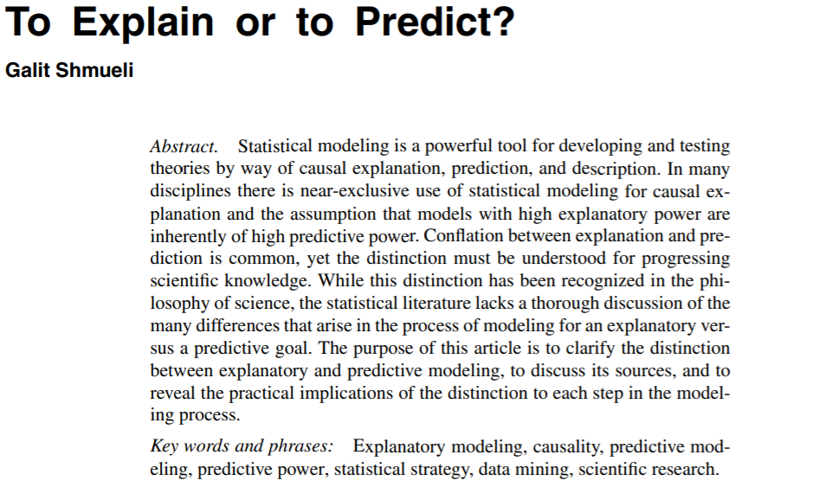
Inference vs Prediction
Still Confused?
Paper by
Galit Shmueli

Slide 17

Data Science – Applications
Focus on problems that would be difficult to solve with traditional programming. For example, imagine creating a system that provides automatic email replies; there is no clear out-of-box solutions through traditional programming that could deliver on such demand. By contrast, machine learning can provide an optimal solution by understanding the structures behind human communications and email correspondence.
"What problem is my product facing?"
"Would it be a good problem for ML?"
(Don't ask the questions the other way around!)
Notes:
Good & Bad ML application
https://hbr.org/2016/11/how-to-tell-if-machine-learning-can-solve-your-business-problem

Slide 18
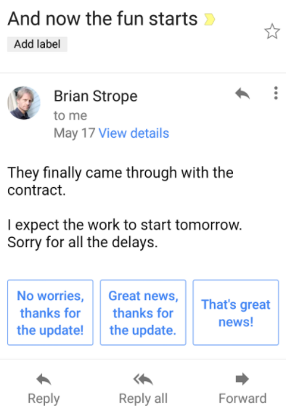
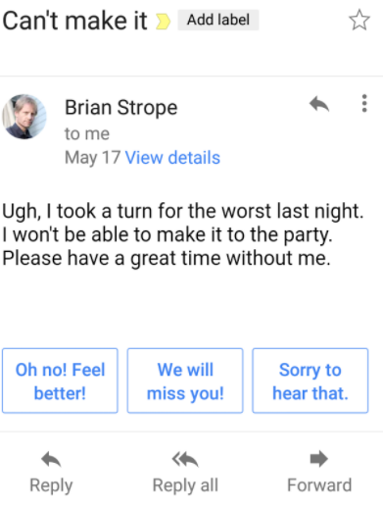
Data Science – Applications
“The Smart Reply- a product that can predict likely responses can save user time.”
Notes:
Good & Bad ML application
https://hbr.org/2016/11/how-to-tell-if-machine-learning-can-solve-your-business-problem

Slide 19
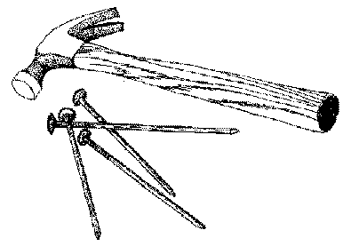
Data Science – Limits
Do you need Data Science in the first Place?
Machine learning has "awe-inspiring applications", yet this does not mean that it can solve all of world's problems. "There is a time for everything"-a time to use ML and a time not to use it.
Occam Razor's (simplicity)
Automation vs Learning (necessary)
Ethics (what is right & what is wrong?)
Data (is there available data?)
Interpretability ("Black Box Problem")
Reproducibility (sharing code)
Notes:
HBR
https://hbr.org/2016/11/how-to-tell-if-machine-learning-can-solve-your-business-problem
When not to use ML
https://www.springboard.com/blog/data-science/when-not-to-use-ml/

Slide 20
Data Science – Limits
"Make everything as simple as possible, but not simpler." - Albert Einstein
Occam's Razor
"A scientific and philosophical rule that entities should not be multiplied unnecessarily which is interpreted as requiring that the simplest of competing theories be preferred to the more complex or that explanations of unknown phenomena be sought first in terms of known quantities."
Occam's Razor is a principle that attempts to remove complexity where it is not necessary. It doesn't attempt to make things "simpler", but simply opts out for the less complex solution, granted it leads to the same result.
As a result, if a particular problem doesn’t necessities of machine learning to deliver an optimal solution, then one should not pursue machine learning methods.
"Think of ML as just one of the tools in your toolkit and only bring it out when appropriate."

Slide 21
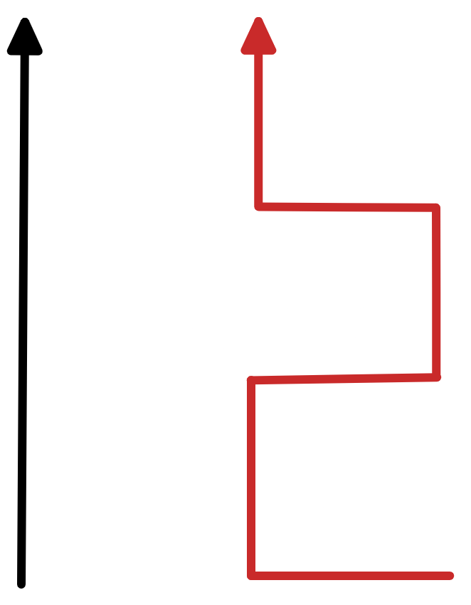
Data Science – Limits
Complexity-Interpretability Tradeoff
There are many methods and models in the data science toolbox, some are less flexible (more restrictive), in the sense that they attempt to simplify the complexities present in the data by relying on a set of assumptions and impose a particular structure on the data. For example, linear regression is an inflexible approach, because it can only generate linear functions.
In contrast, other methods, such as deep learning and neural networks, are considered to be more flexible because they assume nothing about the data and don’t impose any limiting structures, and in turn allow to cover and model much more complex relationships.
When inference is the goal, there are clear advantages to using simple and relatively inflexible statistical learning methods given they are more interpretable.
When prediction is the goal and interpretability is of no interest, more flexible approaches might lead to better results.

Slide 22
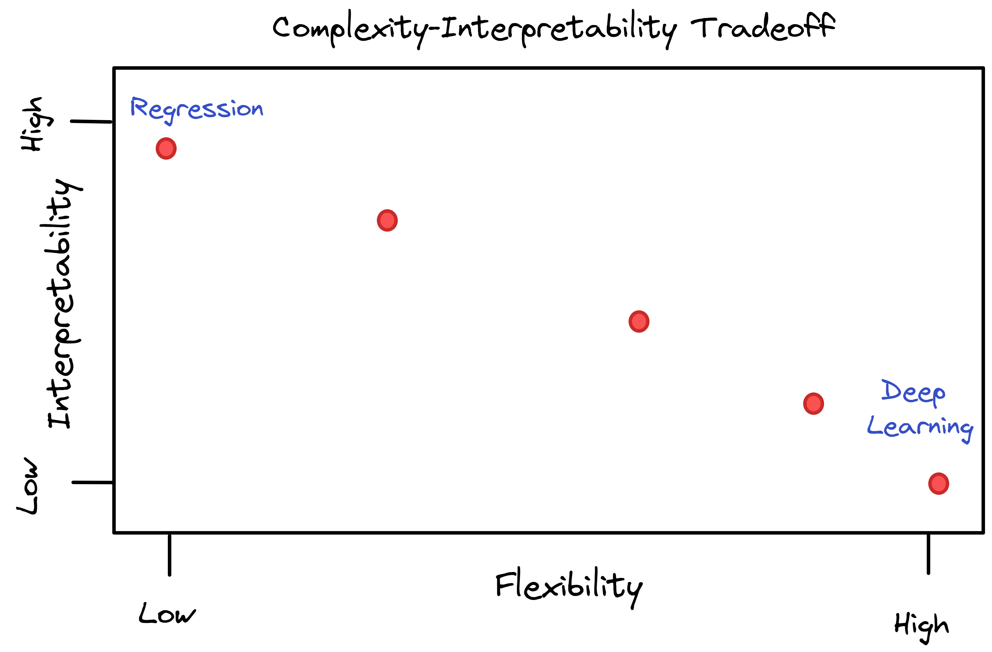
Data Science – Limits
Complexity-Interpretability Tradeoff

Slide 23
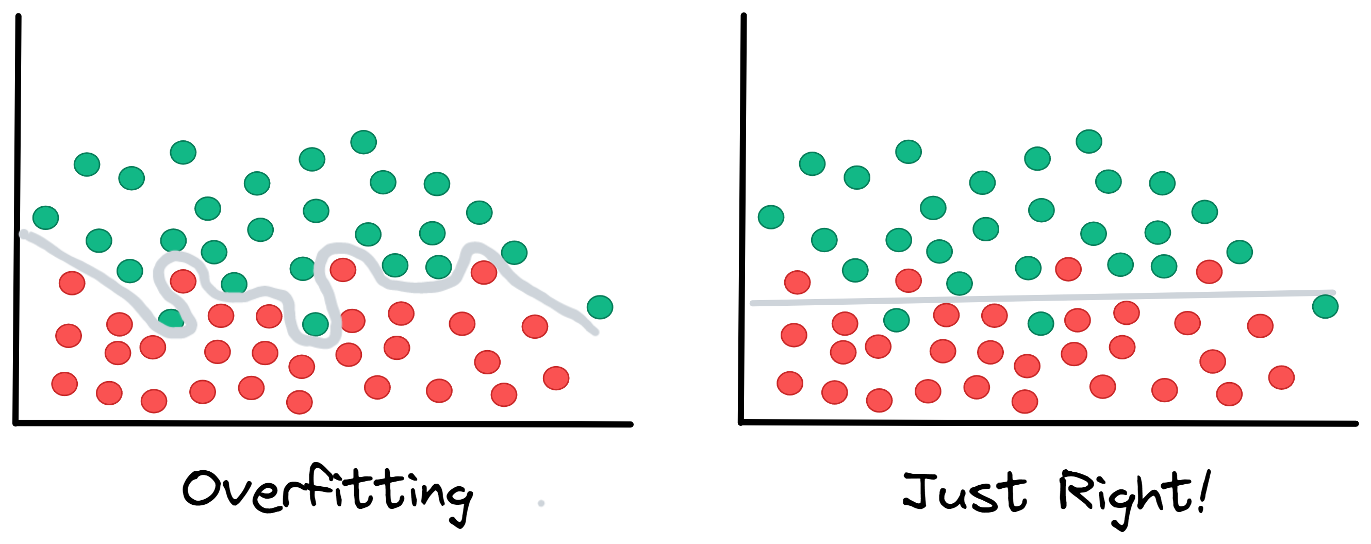
Data Science – Limits
“Why would one ever choose a more restrictive method instead of a very flexible approach?”
Although, one might expect the most flexible alternative to be the superior choice, it is not always the case! This phenomenon, which may seem counterintuitive at first glance, has to do with the potential for overfitting (mistaking noise and randomness for actual meaningful patterns/ relationships) in highly flexible methods.

Slide 24
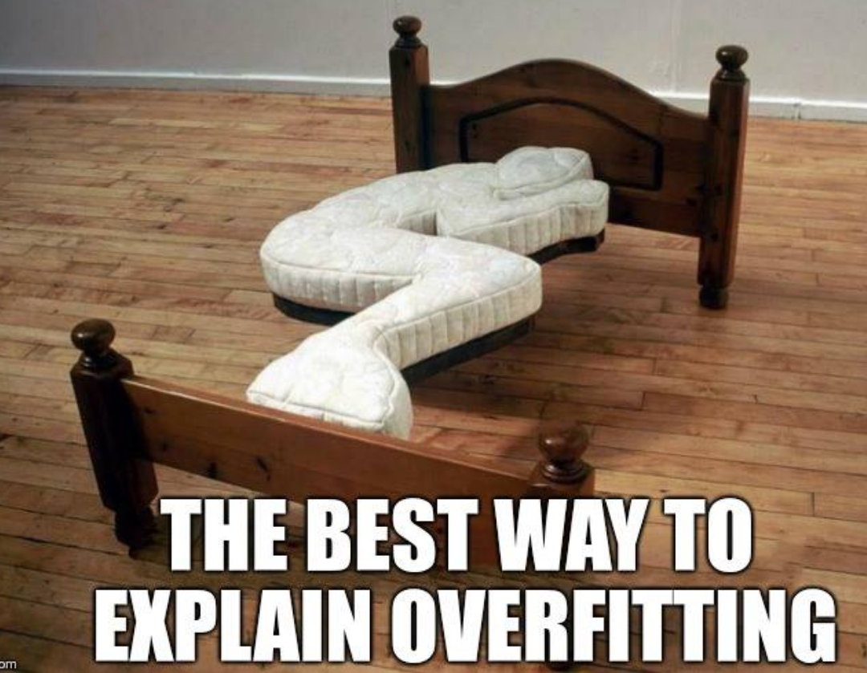
Data Science – Limits
Overfitting
Notes:
Further Resources
https://datacadamia.com/data_mining/overfitting

Slide 25

Data Science
Machine learning, at its core, is a set of statistical methods meant to find patterns of predictability in datasets (even when there are no patterns in there).
Apophenia - "the tendency to perceive meaningful connections between unrelated things."

Slide 26
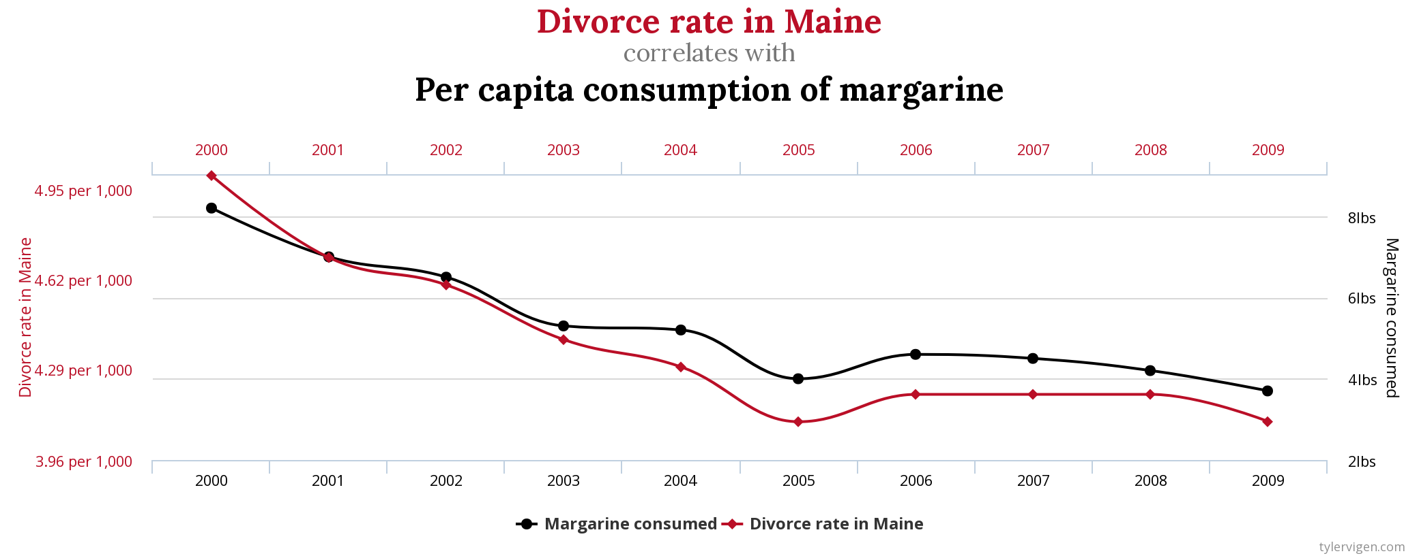
Data Science – Limits
Spurious Correlations
"Spurious Correlations was a project I put together as a fun way to look at correlations and to think about data."- Tyler Vigen

Slide 27
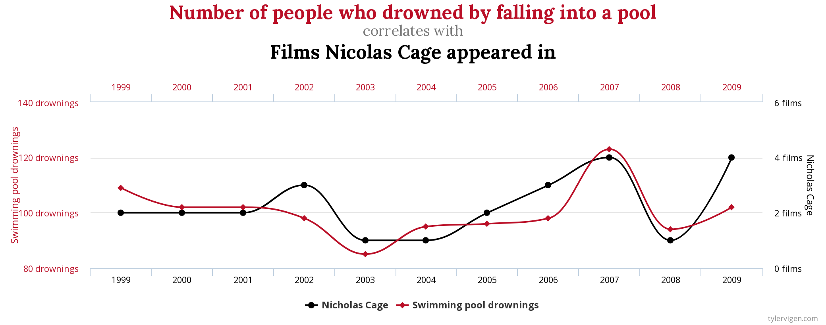
Data Science – Limits
Spurious Correlations

Slide 28
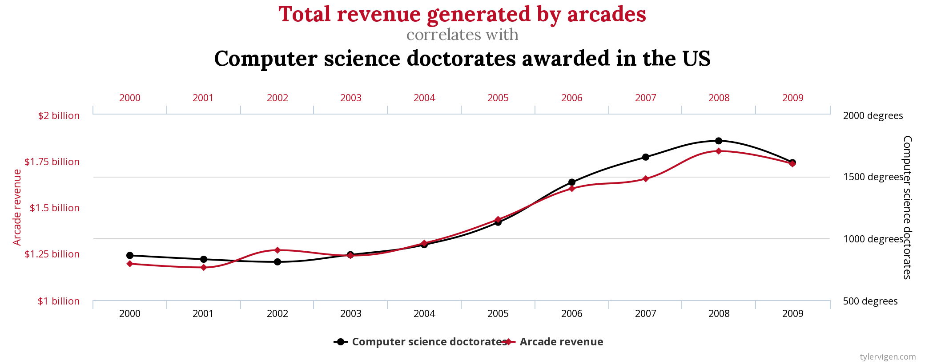
Data Science – Limits
Spurious Correlations

Slide 29
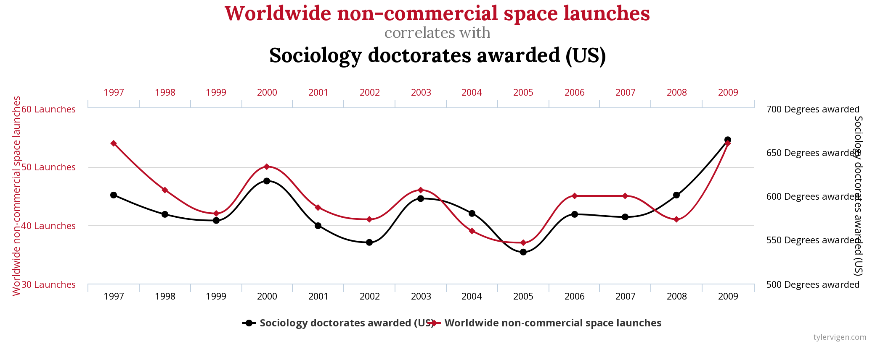
Data Science – Limits
Spurious Correlations

Slide 30
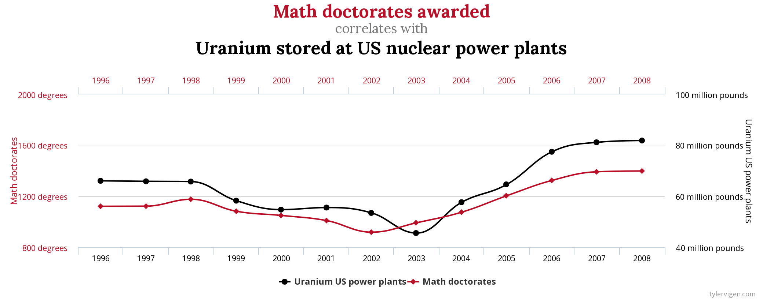
Data Science – Limits
Spurious Correlations

Slide 31
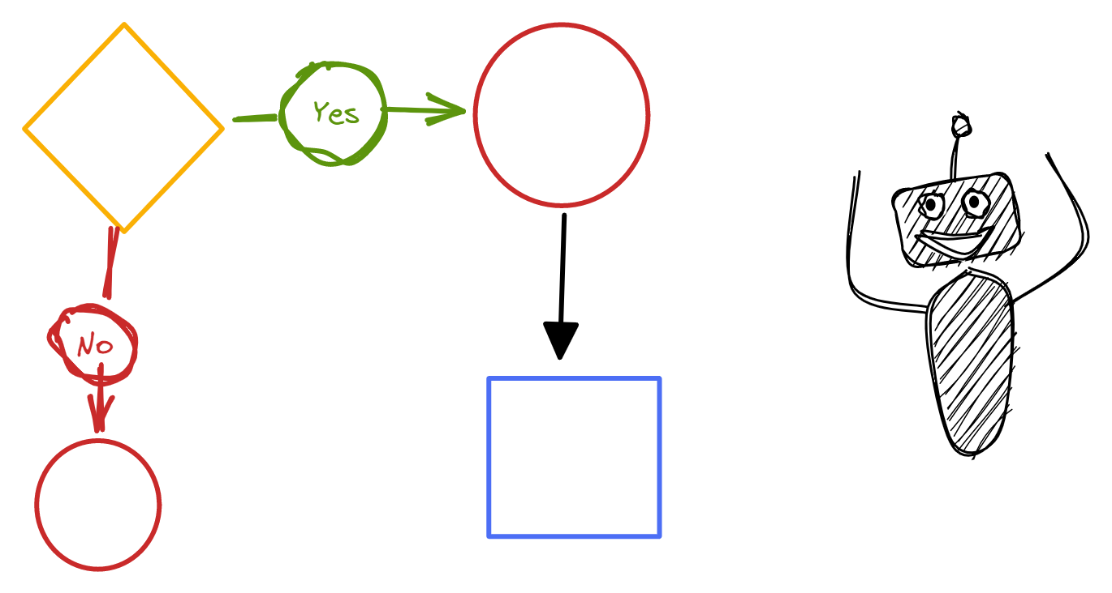
Data Science – Limits
Automation vs Learning
One should distinguishing between automation and learning to avoid unnecessary complexity.
Automation can be viewed as a rigid set of pre-defined rules that accomplishes repetitive and monotonous tasks. This is much like a helper that takes care of process that don't require much "intelligence" but are necessary in order to optimize efficiency and productivity. For example, a system that reads in time cards and uploads them to a database is an automation task. Automation should be used when tasks have a clear and pre-defined series of steps.
Learning involves the use of artificial intelligence and is designed to simulate human thinking. This is a superior method, that attempts to solve "non-straightforward" problems, where mere automation is not enough. For example, a system that recognizes people when they come to work, and is able to automatically update their time cards (in/out), requires learning about people's faces and possibly their habits. Hence, simulating the intelligence of a human.
"Machine learning can help automate your processes, but not all automation problems require learning." HBR

Slide 32
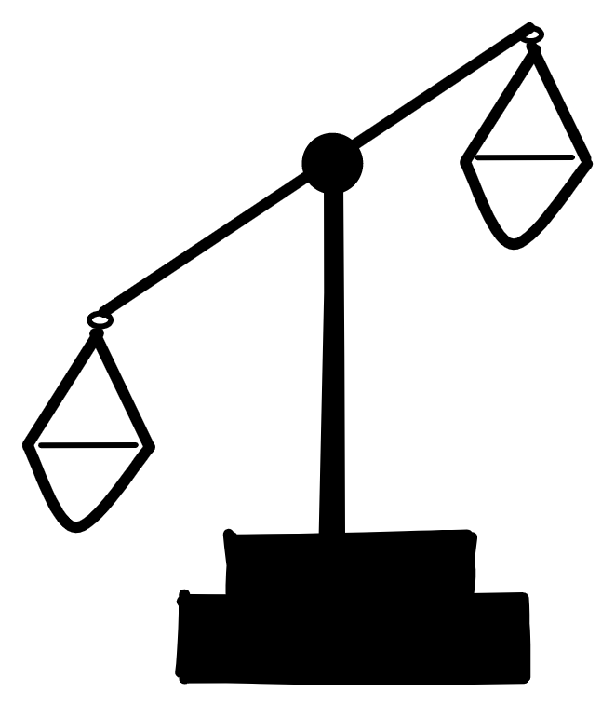
Data Science – Limits
Ethics
AI is about creating intelligent machines that enrich society, but when they take over and are in charge of the decisions that shape the world ethical dilemmas arise.
In the case of self-driving cars (e.g. Tesla), if the possibility of an accident is anticipated, how should the decision process be made? How can such a process be audited and scrutinized? Who dictates that process (law makers, automakers or drivers)? In the case of tragedy who bears the responsibility of the accident (driver, Tesla, original programmer)? How is the fairness of these systems assessed and validated? How is misuse prevented?
The challenges of AI, are not technological, but rather ethical for they encompass issues revolving around privacy, bias, and deep philosophical whose answer have plagued civilization since its dawn and still arise discussion.
“Many of the algorithms that decide who should get parole, or who should be presented with employment opportunities or housing … replicate and embed the biases that already exist in our society.”- Michael, Sandel
Notes:
https://www.eteam.io/blog/the-dark-side-of-artificial-intelligence-and-machine-learning
https://towardsdatascience.com/the-limitations-of-machine-learning-a00e0c3040c6
https://www.eteam.io/blog/the-dark-side-of-artificial-intelligence-and-machine-learning
https://www.ibm.com/cloud/learn/ai-ethics
https://whatis.techtarget.com/definition/AI-code-of-ethics
https://www.nature.com/articles/s41599-020-0501-9
https://betterprogramming.pub/should-you-use-machine-learning-73a7746f7280
Are you fully aware of the societal effects of your machine learning model? For example, have you researched whether or not this model may further socioeconomic inequality, or if it may create divisions between people in different socioeconomic groups? It is important that you fully understand the effects of your model beyond your specific engineering or business problem. If your model is prone to algorithmic bias, it is important that you try to address this problem ahead of time, and try to create a training pipeline that removes as much bias as possible from the data. In addition, it is important to be aware of how this model may be abused by adversaries. Are there any ways for personal information to be obtained by reverse engineering the model’s outputs? Can industry secrets be leaked? With respect to these issues, it is important that you understand what data is visible through the outputs of your model, and who is able to access these outputs directly. It may be useful to obfuscate the outputs, so that you can control what information is revealed, and provide strictly what is necessary.

Slide 33

Data Science – Limits
"Amazon scraps AI recruiting tool showing bias against women."
Notes:
https://www.nature.com/articles/s41599-020-0501-9

Slide 34
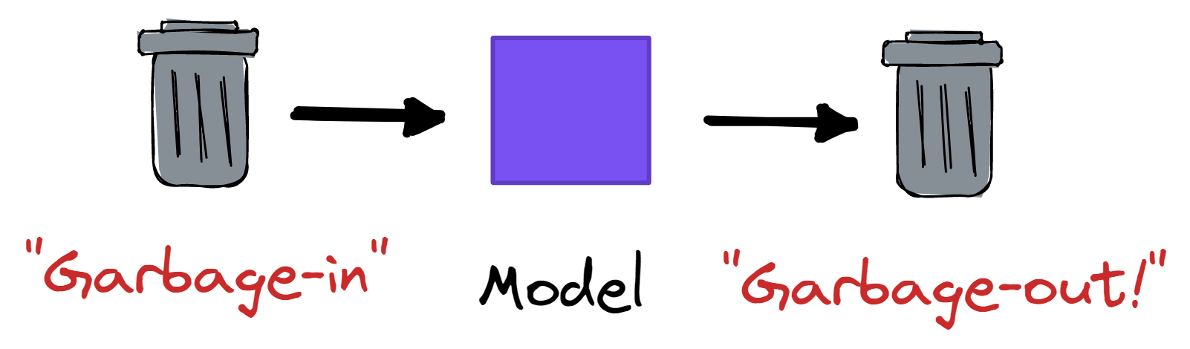
Data Science – Limits
Data Availability
The decision making process of machine learning methods is driven by the patterns that are present in the data. These patterns are assumed to be representing the truth, yet they themselves depend upon the trustworthiness and "impeccability" of the data.
In theory, one expects that the data that is used represents, the truth, but that is not always the case. Datasets, for one reason or another, are sources of biased patterns, which leads to biased decisions (not optimal).
Data machine learning systems are “data-hungry”, for they require a lot of data and good data in order to find meaningful patterns and lead to useful predictions/decisions. The data must accurately represent the real-world case to result in useful and accurate predictions/decisions.
Poor data leads to poor results. Hence, if data availability is an issue, then machine learning might not be attainable.
"Do I have enough data and of high quality?"
Availability <https://betterprogramming.pub/should-you-use-machine-learning-73a7746f7280>

Slide 35
Data Science – Limits
Data Availability
"How much is "a lot?" That depends on the problem, but more data typically improves your model and therefore your model's predictive power. A good rule of thumb is to have at least thousands of examples for basic linear models, and hundreds of thousands for neural networks. If you have less data, consider a non-ML solution first." https://developers.google.com/machine-learning/problem-framing/good
"A paper claiming to have produced an ML classifier distinguishing criminals from non-criminals using only facial images, with allegedly overwhelmingly high accuracy (Wu & Zhang, 2016). As Bergstrom and West (2020) critique, their labels were problematically derived from the source of the photos: Criminals were taken from prison mug shots, while non-criminals were taken from professional social network profiles. Because people generally do not smile in mug shots but do smile in profile photos, Bergstrom and West argue that the original team effectively built a smile classifier, but claimed it was a criminality classifier." MIT Press Direct
"Your Data Is Bad, Your Machine Learning Tools Are Useless" Thomas Redman
https://hbr.org/2018/04/if-your-data-is-bad-your-machine-learning-tools-are-useless

Slide 36
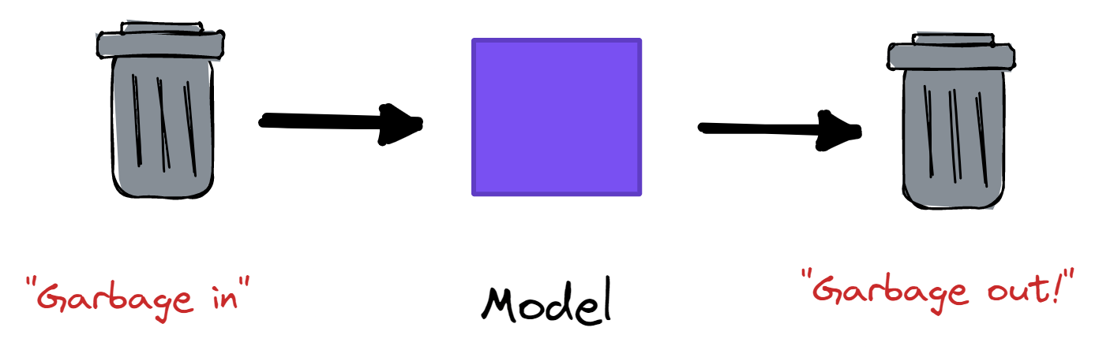

Data Science – Limits
Bad data, bad results!

Slide 37

Data Science – Limits
Interpretability ("Black Box")
One of the most pressing critiques of AI is its inability to provide clarity as to the reasoning behind the choices and decisions; depending on the methods, some more than others, it is difficult to explain how and why these algorithms manage to produce accurate results. This is often referred to as “black-box problem” and is one of the dark sides of artificial intelligence, for it impedes direct access and scrutiny of the underlying mechanisms and potential bias.
Interpretability is a major issue especially with (popular) deep learning algorithms, which have great potential and advantageous benefits, but become questionable when consequences are significant, for example- large scale discrimination based on gender and race- "leading to loss of trust from users and outright rejection in some case."
The aim should be to go from black-box to glass-box models (i.e. inspectable models).
“Machines are beneficial to the extent that their actions can be expected to achieve our objectives.” - Stuart Russel
Notes:
https://www.scientificamerican.com/article/demystifying-the-black-box-that-is-ai/
https://www.nature.com/news/can-we-open-the-black-box-of-ai-1.20731
https://hdsr.mitpress.mit.edu/pub/f9kuryi8/release/6

Slide 38
Data Science – Limits
Example – expand!
---work in progress--- For example, researchers at the University of Pittsburg in the late 1990s evaluated machine learning algorithms for predicting mortality rates from pneumonia. The algorithms recommended that hospitals send home pneumonia patients who were also asthma sufferers, estimating their risk of death from pneumonia to be lower. It turned out that the dataset fed into the algorithms did not account for the fact that asthma sufferers had been immediately sent to intensive care, and had fared better only due to the additional attention.

Slide 39
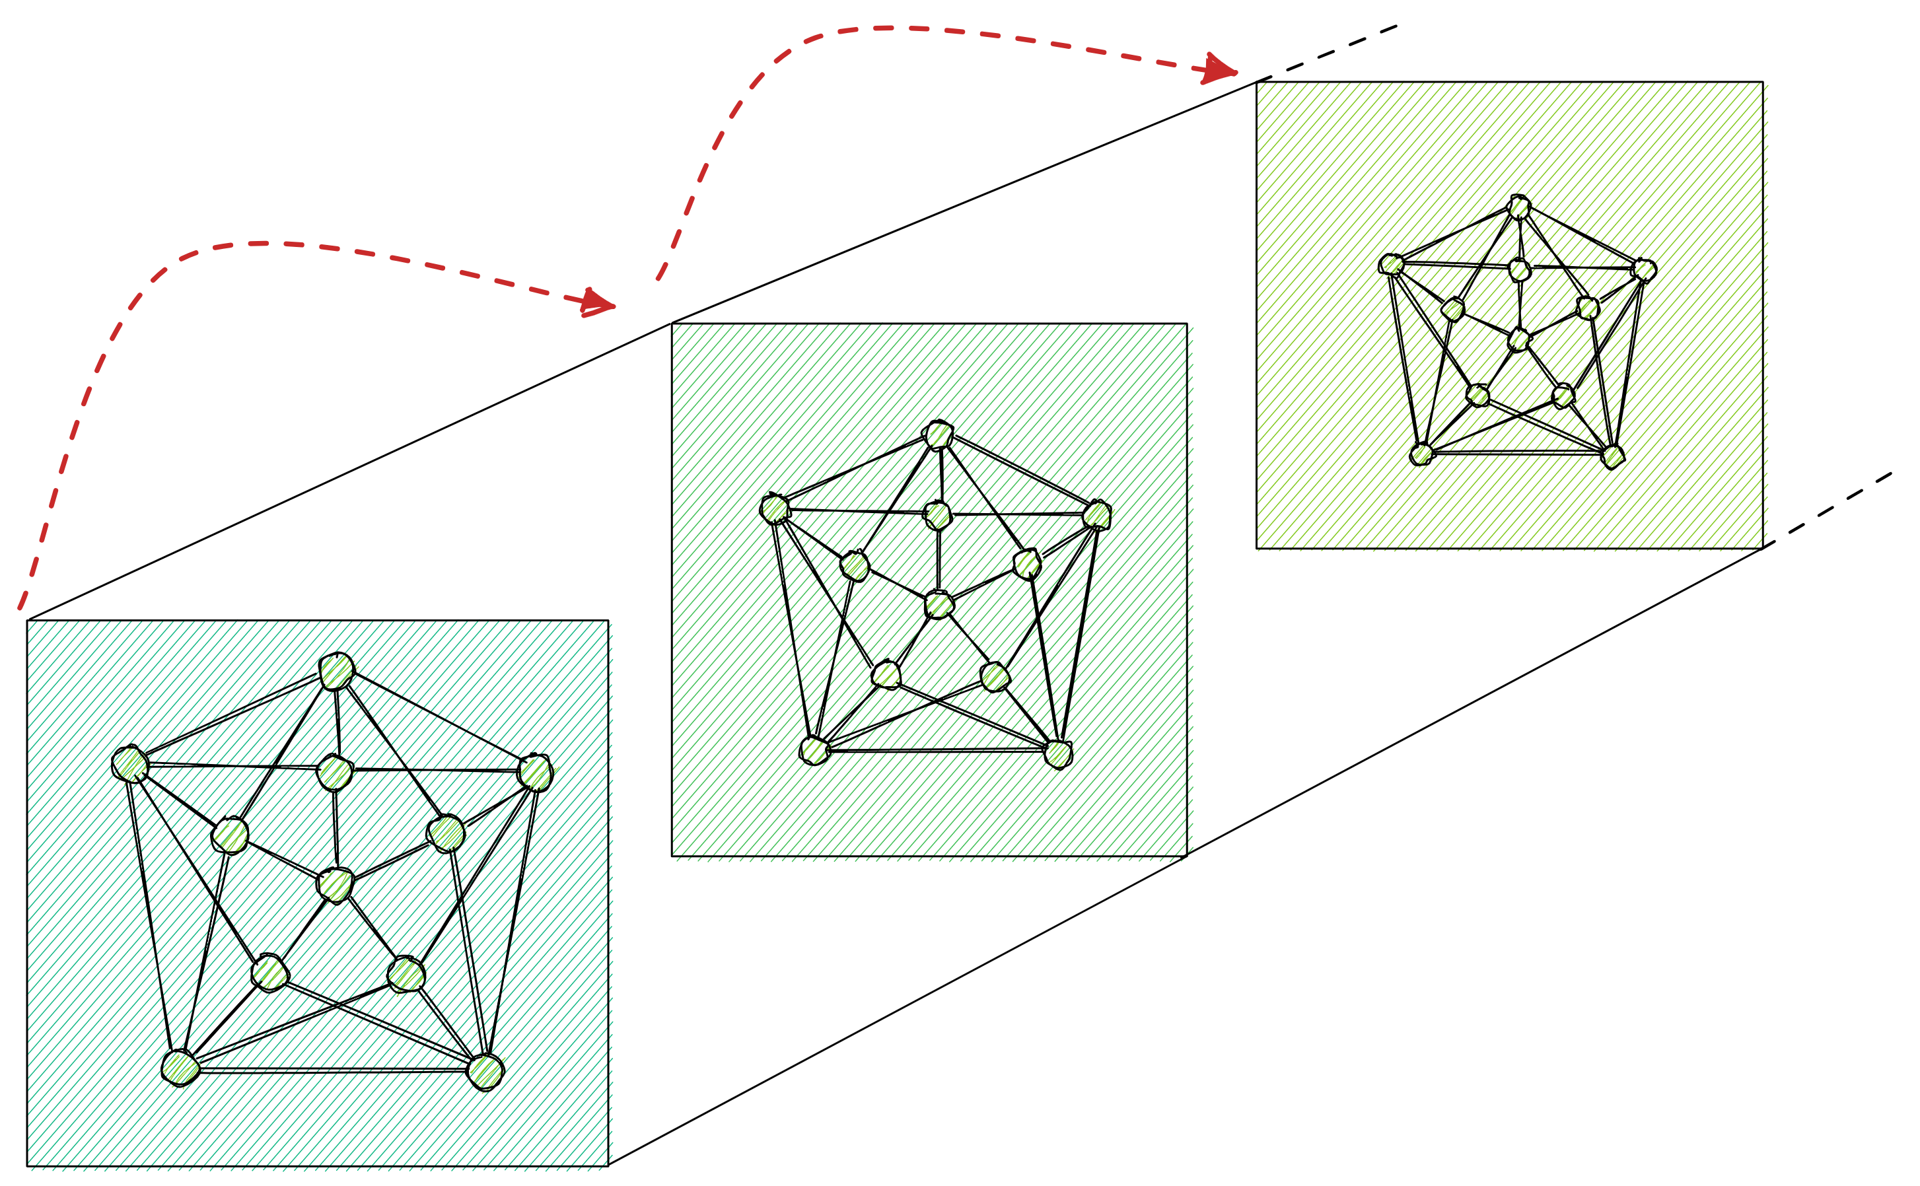
Data Science – Limits
Good Science
National Institute of Health (NIH) specifies two cornerstones that allow for the advancement of science rigor and reproducibility.
"The application of rigor ensures robust and unbiased experimental design, methodology, analysis, interpretation, and reporting of results. When a result can be reproduced by multiple scientists, it validates the original results and readiness to progress to the next phase of research. This is especially important for clinical trials in humans, which are built on studies that have demonstrated a particular effect or outcome."
In recent years, the awareness of furthering rigor in research settings in order to create re-producible studies has been steadily growing; as a result, any scientific domain that attempts a scientific effort, should aim to satisfy such vital cornerstones.

Slide 40
Data Science – Limits
Reproducibility
Reproducibility, refers to the ability of "obtaining consistent results using the same methods, conditions of analysis, input data, and computational steps” (Torrington, 2021) among independent group of researchers. In a perfect world, scientists should be able to recreate experiments, obtain similar results, and eventually reach the same conclusions. This redundancy allows for the validation of results, which in turn facilitates readiness to progress onto the next phase of research.
Why is it reproducibility important?
"The credibility of scientific claims rely in the evidence supporting them (methodologies, data, analysis, and outcome); these in turn become credible by the community consensus" (Munafo, 2017); So that a particular matter becomes useful, not so much as in its discovery alone, or as a result of a particular scientist, but rather as a result of its confirmation and adoption by the masses.

Slide 41
Data Science – Limits
Lack of Reproducibility
A lack of reproducibility can have a negative impact on progress, create wastefulness of resources (time, funds), and ultimately cause a loss of the public’s trust in science and its community. Hence, it is imperative to pursue practices that facilitate reproducibility.
Science is built on trust, which involves sharing enough details about how research is done to enable others to replicate it, verify it, and use it as a stepping stone for future research.
Issues
Non-verifiable claims/conclusion
Biased datasets go unnoticed and perpetuate into the real world
Barriers to ML progress
“This is how science self-corrects and weeds out results that don’t stand up.”

Slide 42

Data Science – Limits
Below are some further resources (short clips) developed by NIH that bring more light on reproducibility and its components.
"These modules, comprised of videos and accompanying discussion materials, were developed by NIH, and focus on integral aspects of rigor and reproducibility in the research endeavor, such as bias, blinding, and exclusion criteria. The modules are not meant to be comprehensive, but rather are intended as a foundation to build on and a way to stimulate conversations."
Notes:
https://www.nigms.nih.gov/training/documents/introduction-to-the-modules.pdf

Slide 43

Data Science – Limits
1. Lack of Transparency

Slide 44

Data Science – Limits
2. Blinding and Randomization

Slide 45

Data Science – Limits
3. Biological and Technical Replicates

Slide 46

Data Science – Limits
4. Sample Size, Outliers, and Exclusion Criteria

Slide 47
Data Science – Limits
Current Reproducibility Trends
The current sentiment in reproducibility builds on the backs of the Open Science -"transparent and accessible knowledge that is shared and developed through collaborative networks."
Reproducibility in the AI setting means providing code and data to further reinforce the support for the claims that are made available; although, perfect reproducibility might not always be a possibility, the importance relies in the ability to reconcile among the differences. With open science, sharing code and data with each published paper becomes the general default.
For example, since 2016, all Nature (publisher) journals require that authors make materials, data, code and associated protocols promptly available to readers on request that are "necessary [in order] to interpret, replicate and build on the reported findings."
“It’s true that running the same code on the same data is not advancing science, but it is necessary to advance science.” Monya Baker

Slide 48
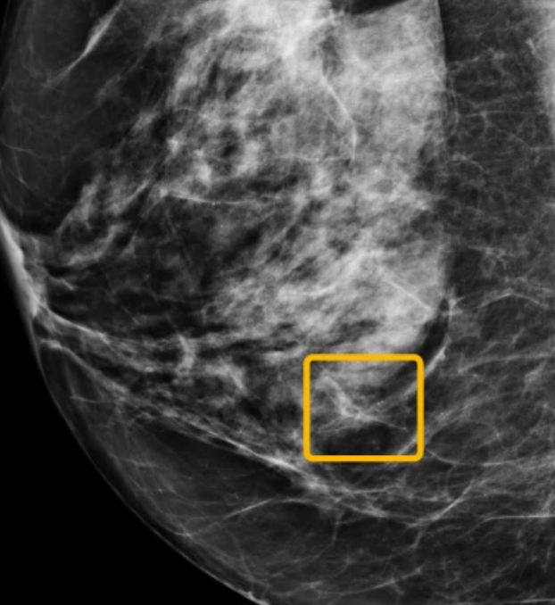
Data Science – Limits
Current Reproducibility Trends
An “army” of 31 scientists published a damning response in rage to a study published by Google Health. The study itself was a positive one, for it described successful attempts of an AI application discovering signs of breast cancer in medical images.
The major critique of the paper, wasn’t research related, but more directed to the practice of withholding critical pieces of information necessary for reproducibility and verification such as code and testing mechanisms. To the scientists Google’s paper “amounted to nothing more than a promotion of proprietary tech.” Although, there are barriers, the consensus on the future seems to hold open science with accompanying code and data (when applicable).
“When we saw that paper from Google, we realized that it was yet another example of a very high-profile journal publishing a very exciting study that has nothing to do with science. It's more an advertisement for cool technology. We can’t really do anything with it.”- H.Kains

Slide 49
Data Science – Limits
Replication Crisis
"The replication crisis (a.k.a. reproducibility crisis) is an ongoing methodological crisis in which it has been found that the results of many scientific studies are difficult or impossible to reproduce; such failures undermine the credibility of science."
According to a 2016 survey, “more than 70% of researchers have tried and failed to reproduce another scientist's experiments, and more than half have failed to reproduce their own experiments” (Baker, 2016).
"Yet, less than 31% think that failure to reproduce published results means that the result is probably wrong, and most say that they still trust the published literature."
The "sometimes-contradictory" attitudes towards reproducibility could be the result of a lack of a consensus on what reproducibility is or should be.

Slide 50
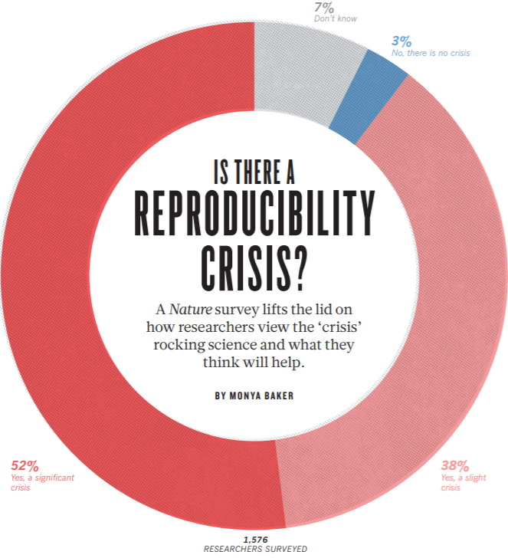
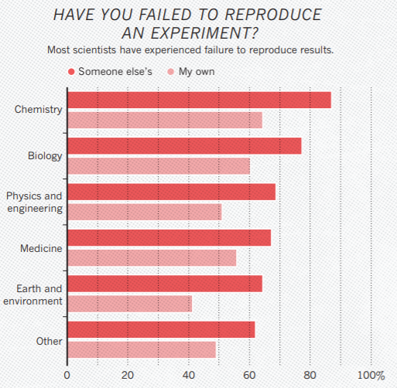
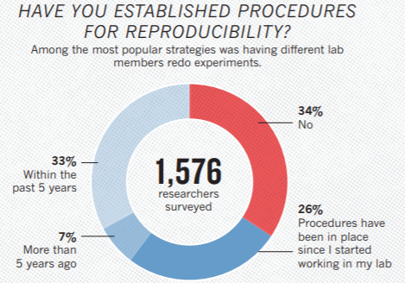
Data Science – Limits
Replication Crisis
Survey from Monya Baker

Slide 51
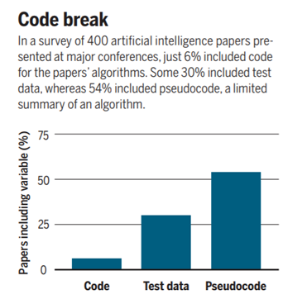
Data Science – Limits
Replication Crisis
“Computational science — like other disciplines — is grappling with reproducibility problems, partly because researchers find it difficult to reproduce results based on custom-built algorithms or software" given the necessity of details such as methods, process, and explicit code required in order reproduce the reported results.
One of the most fundamental problems is the lack of code sharing. For example, according to a survey by O. E. Erik Gundersen, a Norwegian computer scientist, which examined 400 algorithms papers at two very prestigious AI conferences - "only 6% of the presenters shared the algorithm’s code. Only a third shared the data they tested their algorithms on, and just half shared “pseudocode”—a limited summary of an algorithm."
Viz by Matthew Hudson

Slide 52
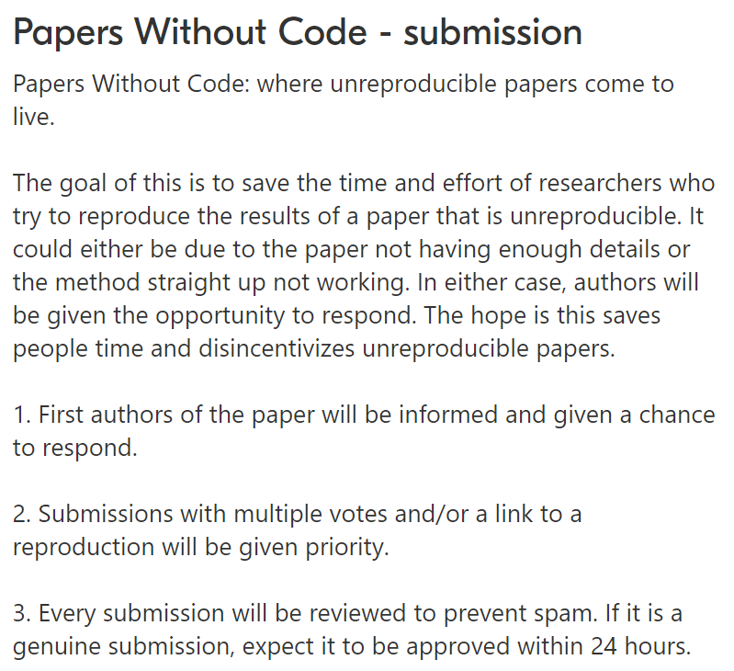
Data Science – Limits
Example of Exasperation
(An Active Website!)

Slide 53
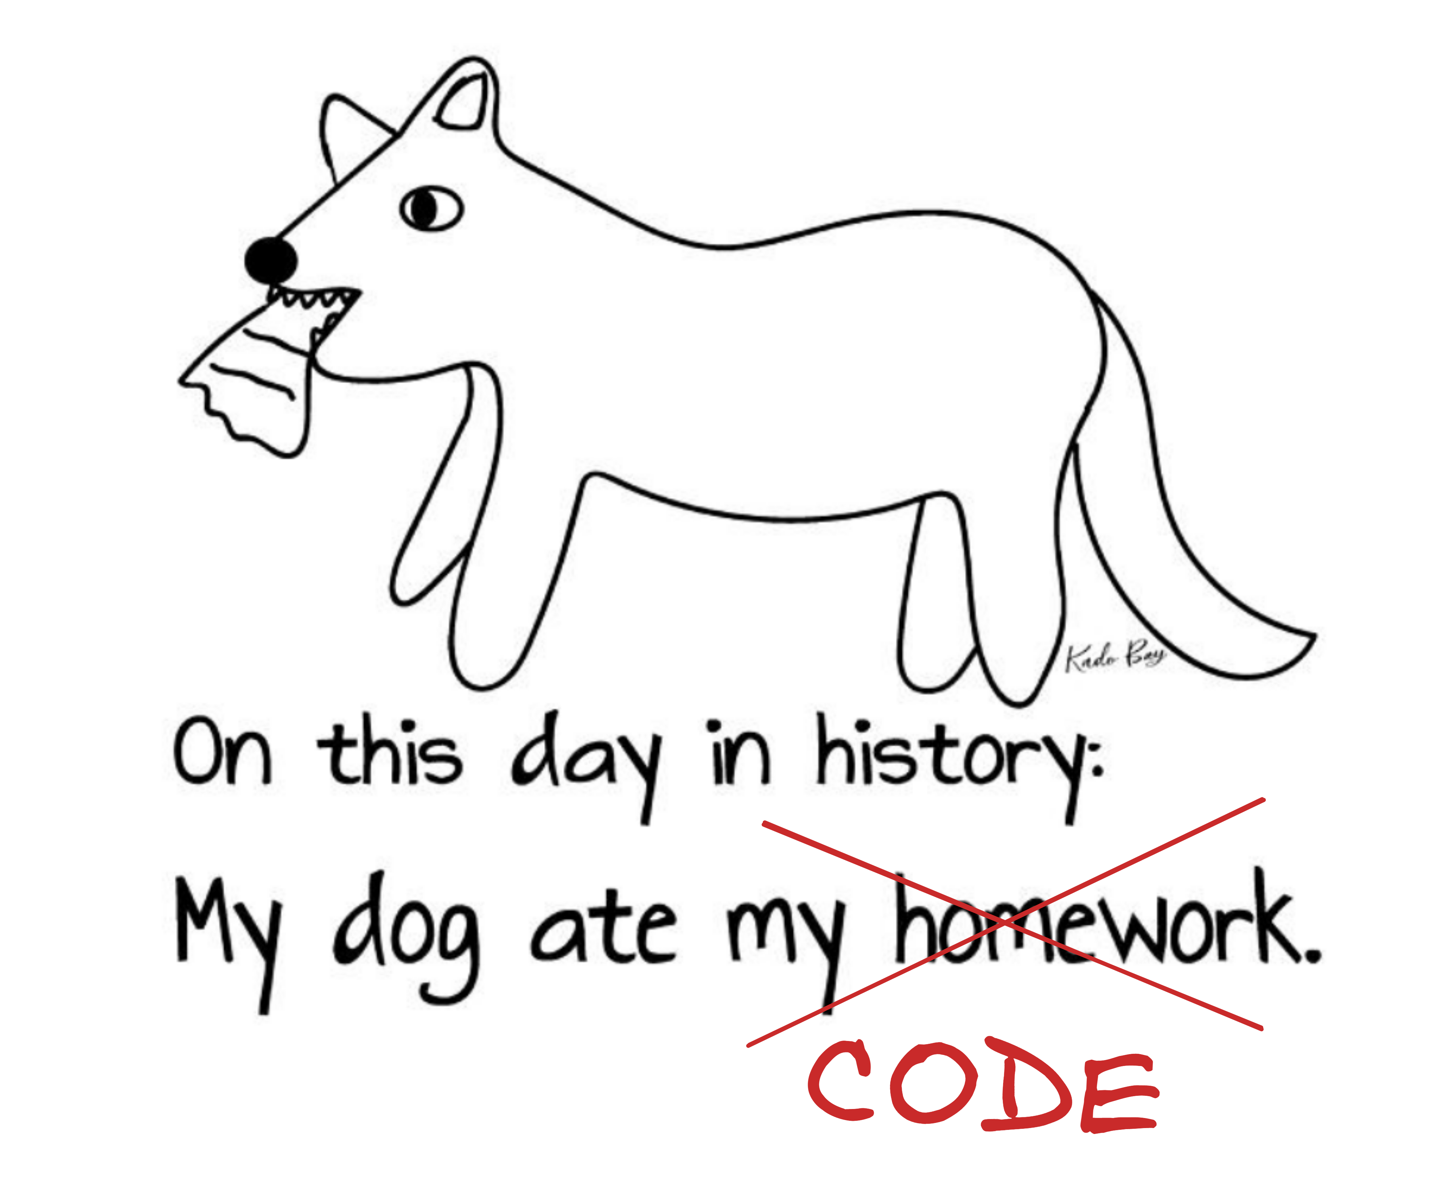
Data Science – Limits
Why Aren't Researchers Sharing?
There are many "reasons" on why sharing might be limited: "the code might be a work in progress, owned by a company, dependent on other code, itself unpublished, or it might be that the code is simply lost—what Rougier calls the “my dog ate my program” problem."
Privacy, regulations or confidentiality result in a lack of public code/data
Selectivity, cherry-picking the best results from several experiments and present them as state-of-the-art achievements- sharing everything "might not look too good" after all.
Cost, resources might be too exhaustive (e.g. an entire cluster of servers)
Incentives, no time, not enough space in the journal, pressure to publish, stay ahead of competition; sharing code, and datasets and in addition to all the different nuances that come with papers requires extra work, without the right incentives in places, a researcher might avoid doing perceived “un-necessary” extra work.

Slide 54
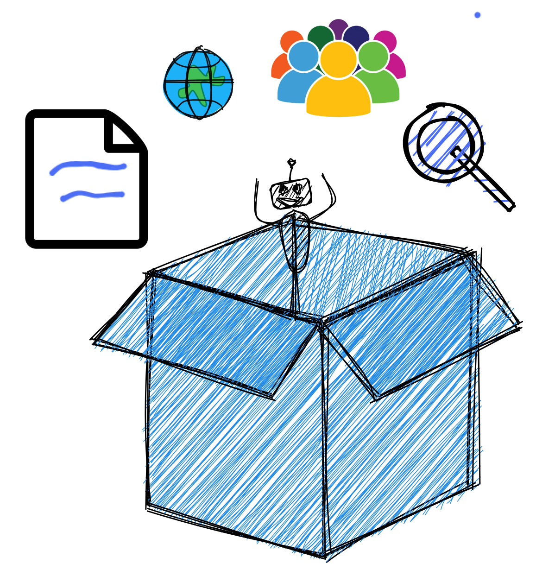
Data Science – Limits
Lack of training?
As Baker mentions in her paper “Reproducibility: Seek out Stronger Science” (2016), in most cases, irreproducibility seems the result of weak experimental designs and poor analytical practices, yet, “few early-career researchers receive formal instruction on these topics.” As a result, the question arises: are there enough resources that can aid new and experienced researchers to learn and hone the skills necessary to make their researcher more valuable?
"Help with experimental design and analysis is more accessible than many researchers realize." The resources are there and a plenty,
Organizations that provide consultations ( Center for Open Science)
Seminars/webinars
Courses (domain-specific preferably)
Faculty members
Scientific societies

Slide 55
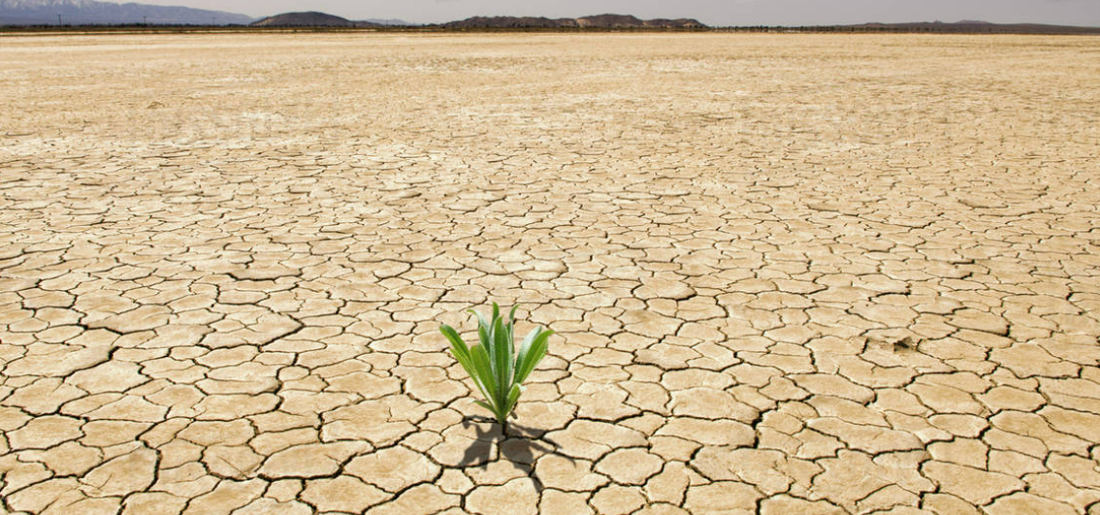
Data Science – Limits
Possible Solutions
“At the current time there is no consensus on what reproducibility is or should be." Baker, 16
Standards, that protect privacy concerns while at the same allow for data-sharing
Guidelines/checklists, that make ML more reproducible
Joelle Pineau's guide & study
Public repositories, git hub, Harvard Dataverse
Badging schemes, (Bronze, Silver, Gold) in accordance with satisfied requirements
Paper
Journals that require data & code, such as Nature, Springer , PLOS One
Apply FAIR Principles to research endeavors
NIH Policies, Data Management Plant
Top 10 reasons to not share data (humor)
"Where there's a will, there's a way."

Slide 56
Data Science – Limits
Principles and Guidelines for Reporting Preclinical Research
In 2004 NIH sponsored a workshop that focused on identifying opportunities to enhance rigor and reproducibility; the result was a general consensus on set of principles that would facilitate these goals.
Rigorous statistical analysis
Transparency in reporting
Data and material sharing
Consideration of refutations
Establish best practices (antibodies, cell lines, animals)
Endorsements
Adapted guidelines
Notes:
Explain each point as explained in the reference website;

Slide 57
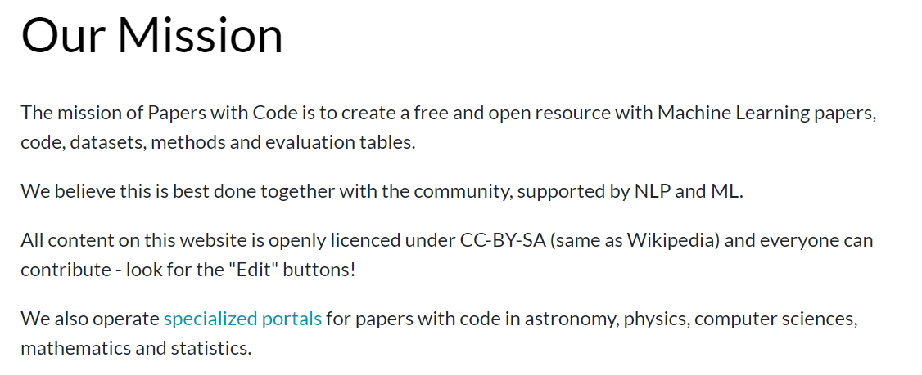
Data Science – Limits
Example of Optimism
(An Active Website!)

Slide 58
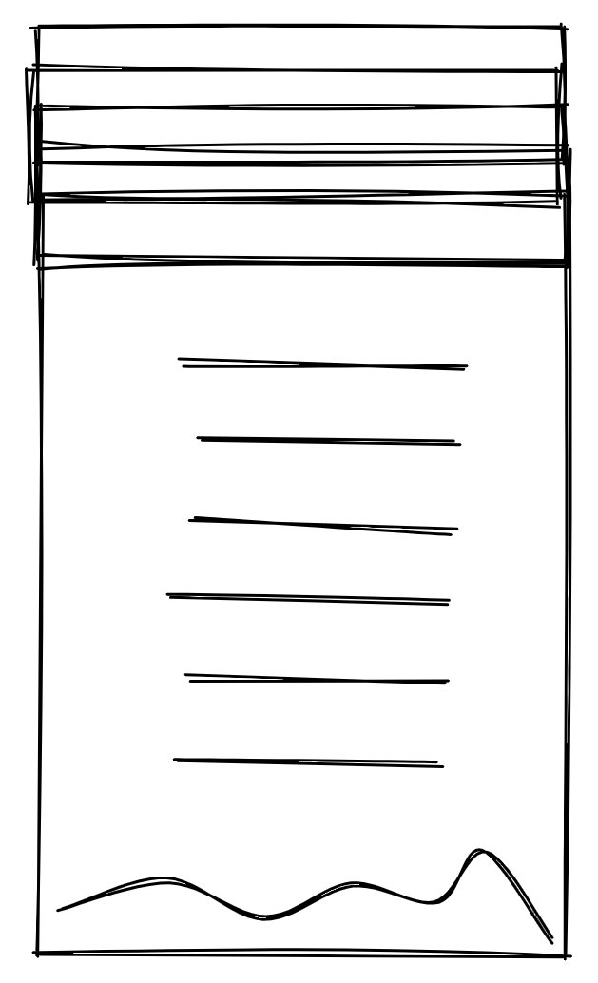
Data Science – Reproducibility Resources
Articles & Papers
The ML Crisis You Should Know About
Reproducibility
One researcher’s mission to encourage reproducibility in machine learning
Transparency and reproducibility in artificial intelligence
Is Artificial Intelligence Permanently Inscrutable?
Biologists
Statistics for Biologists
Ten Simple Rules for Effective Statistical Learning
Training
Training Modules (NIH Initiatives)
Reproducibility in R (Software Carpentry)
More resources

Slide 59
Data Science
Problem Closing Remarks
Statistics starts with a problem, proceeds with the collection of data, continues with the data analysis and finishes with conclusions. It is a common mistake of inexperienced statisticians to plunge into a complex analysis without paying attention to the objectives or even whether the data are appropriate for the proposed analysis.
As Einstein said, the formulation of a problem is often more essential than its solution which may be merely a matter of mathematical or experimental skill.
From "Linear Models in R" by Julian Faraway

Slide 60
Data Science
Good Practices for Statistical Learning
1. Understand the physical background. Statisticians often work in collaboration with others and need to understand something about the subject area. Regard this as an opportunity to learn something new rather than a chore.
2. Understand the objective. Again, often you will be working with a collaborator who may not be clear about what the objectives are. Beware of “fishing expeditions” — if you look hard enough, you will almost always find something, but that something may just be a coincidence.
3. Make sure you know what the client wants. You can often do quite different analyses on the same dataset. Sometimes statisticians perform an analysis far more complicated than the client really needed. You may find that simple descriptive statistics are all that are needed.
4. Put the problem into statistical terms. This is a challenging step and where irreparable errors are sometimes made. Once the problem is translated into the language of statistics, the solution is often routine. Difficulties with this step explain why artificial intelligence techniques have yet to make much impact in application to statistics. Defining the problem is hard to program. That a statistical method can read in and process the data is not enough. The results of an inapt analysis may be meaningless. It is important to understand how the data were collected.
From "Linear Models in R" by Julian Faraway

